Slide 1
Progress Check 3
Разработана учителем английского языка
Чебанюк О. Г.
2017 г.

Slide 2
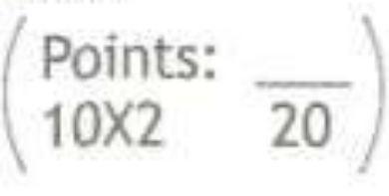
Ex 1 p 56
1 torture 6 survived
2 rustling 7 glimpse
3 violent 8 Sightings
4 dull 9 illusion
5 mythical 10 humped

Slide 3
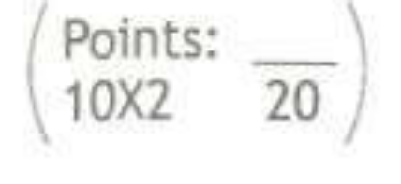
Ex 2 p 56
1 hadn’t gone/been out 6 had been eating
2 had been walking 7 was washing
3 were lying 8 didn’t watch
4 had mown 9 had been cooking
5 was worrying 10 hadn’t finished

Slide 4
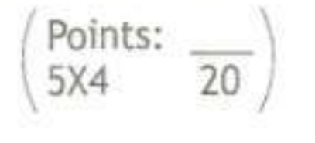
Ex 3 p 56
1 good 4 deep
2 three 5 well
3 blue

Slide 5
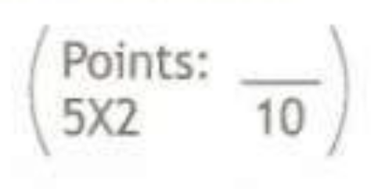
Ex 4 p 56
1 about 3 from 5 in
2 of 4 of

Slide 6
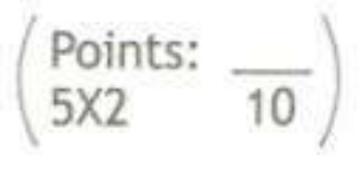
Ex 5 p 56
1 up 3 over 5 down
2 across 4 out

Slide 7
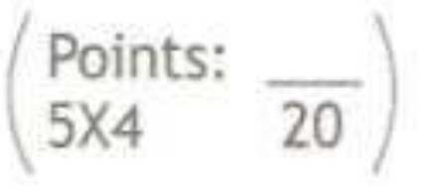
Ex 6 p 56
1 d
2 c
3 e
4 a
5 b

Slide 8
Your mark:
100 – 90 - «5»
89 – 75 - «4»
74 – 50 - «3»
49 – 0 - «2»

